Slide 1



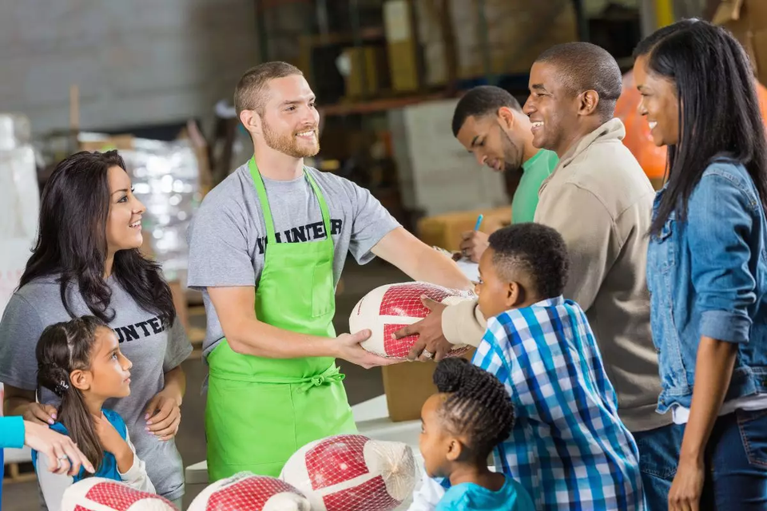

Saht-Ino
Give with heart, help with sadaqa
By N7 Alt
Notes:
Hey everyone! I hope you're all doing well. Today, we'll go over a quick recap of week 1, check out our progress so far, and discuss what’s coming up next.

Slide 2

PROBLEM
Notes:
But first, let’s understand the problem. Restaurants and supermarkets often end up with surplus food—items that are nearing their expiration dates and would otherwise spoil by the end of the day, contributing to food waste. Meanwhile, organizations and food banks dedicated to fighting and reducing hunger face challenges in collecting these types of donations.

Slide 3
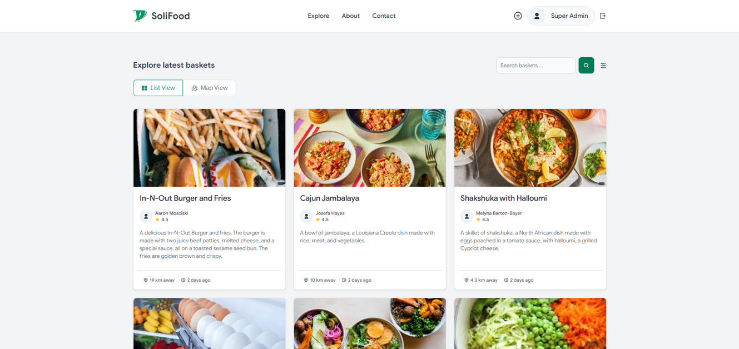
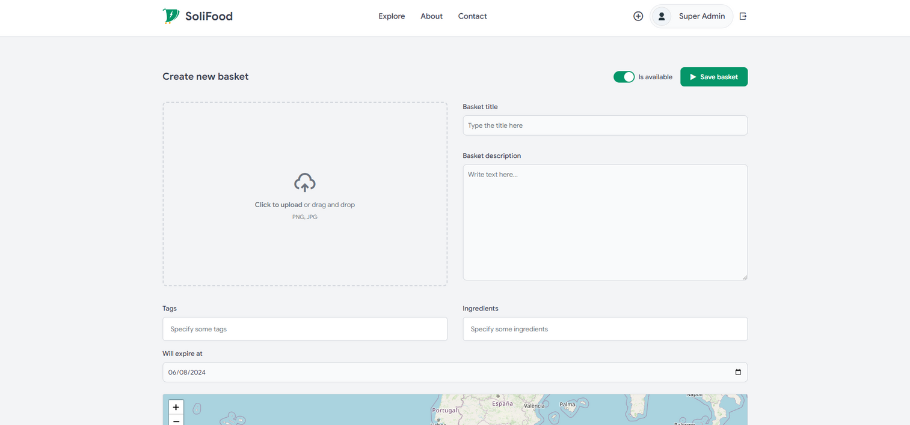
SOLUTION
Notes:
How does it work? It’s actually quite simple, and as they say, the simplest ideas are often the best. Donors can go to our website to post the food they want to donate, along with their location. Collectors can then visit our site to find available donations, select the baskets closest to them, and arrange for pickup. This way, donors help reduce food waste, while collectors work to combat hunger, all through our solution, Solifood.

Slide 4
01
Admin & Collector Dashboard
02
Mobile App
Key features
03
Reporting System
04
Search, Recommendation Systems, and AI Assistant
Notes:
So far, we’ve completed the admin dashboard, reporting system, and search functionality. Next week, our focus will be on implementing the collector’s dashboard and the recommendation system.

Slide 5
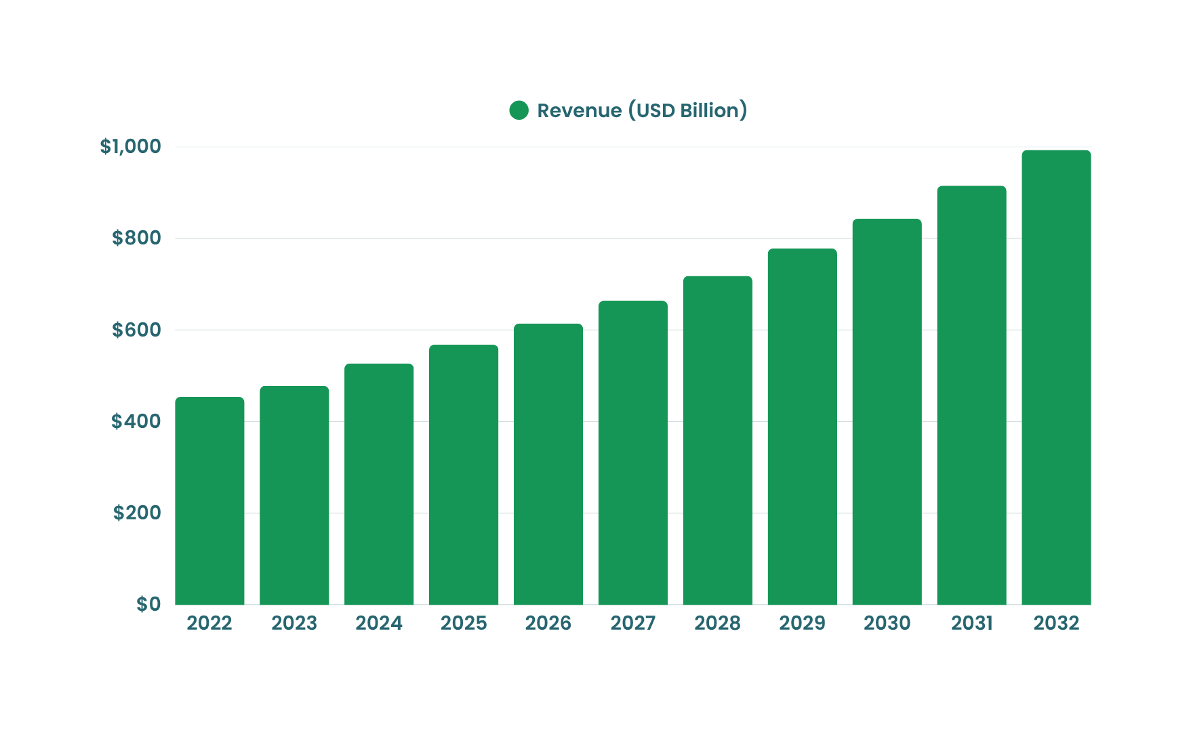
MARKET OPPORTUNITY
Notes:
for our financial projection, for the next 3 years, in the first two years, we will invest in software development, infrastructure, and especially our marketing. In these two years, we will try to break even. and in the third year, we will diversify our income by increasing our partners and advertising

Slide 6
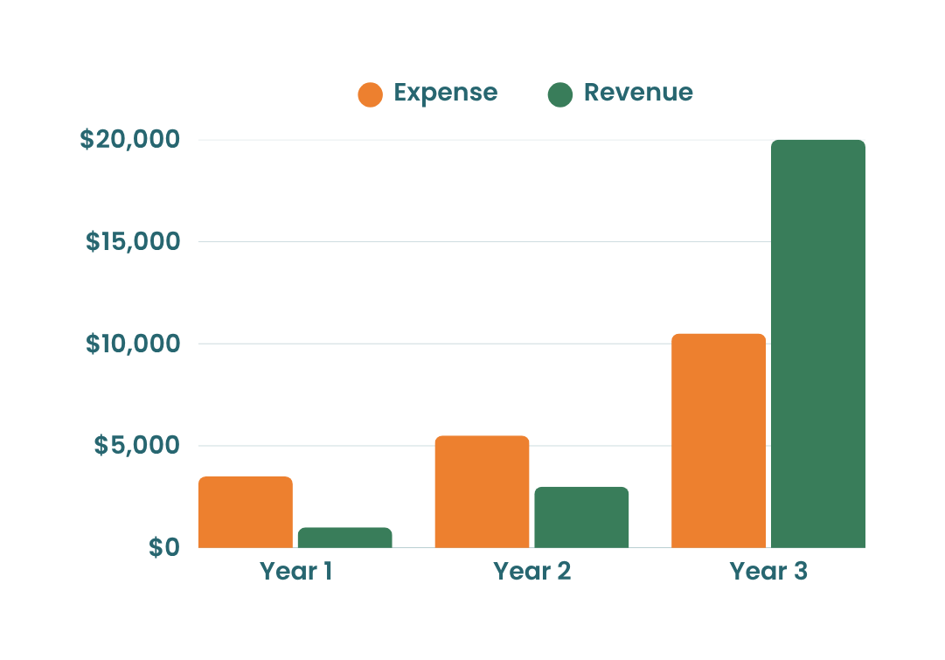
Users: 1000
Partners: 5
Year 1
FINANCIAL PROJECTION
Users: 20,000
Partners: 20
Year 2
Users: 200,000
Partners: 60
Year 3

Slide 7


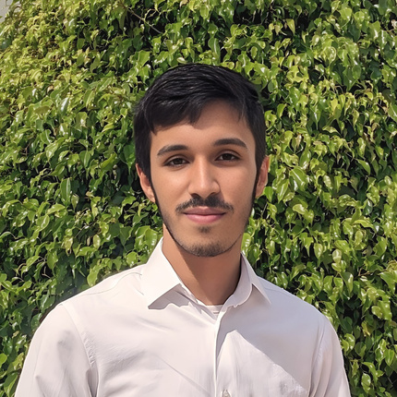
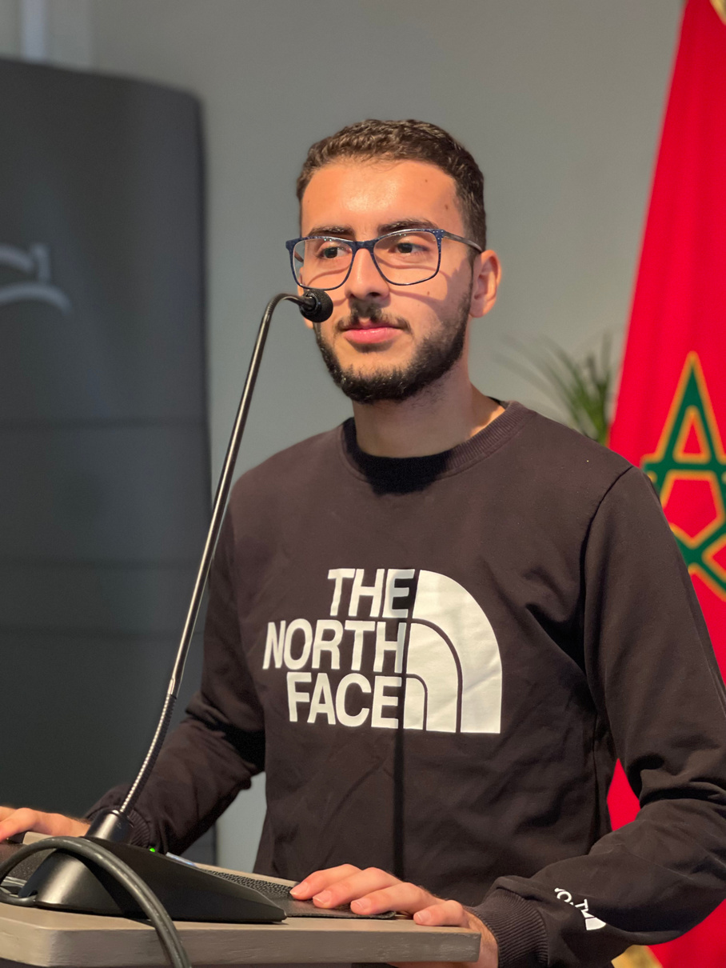
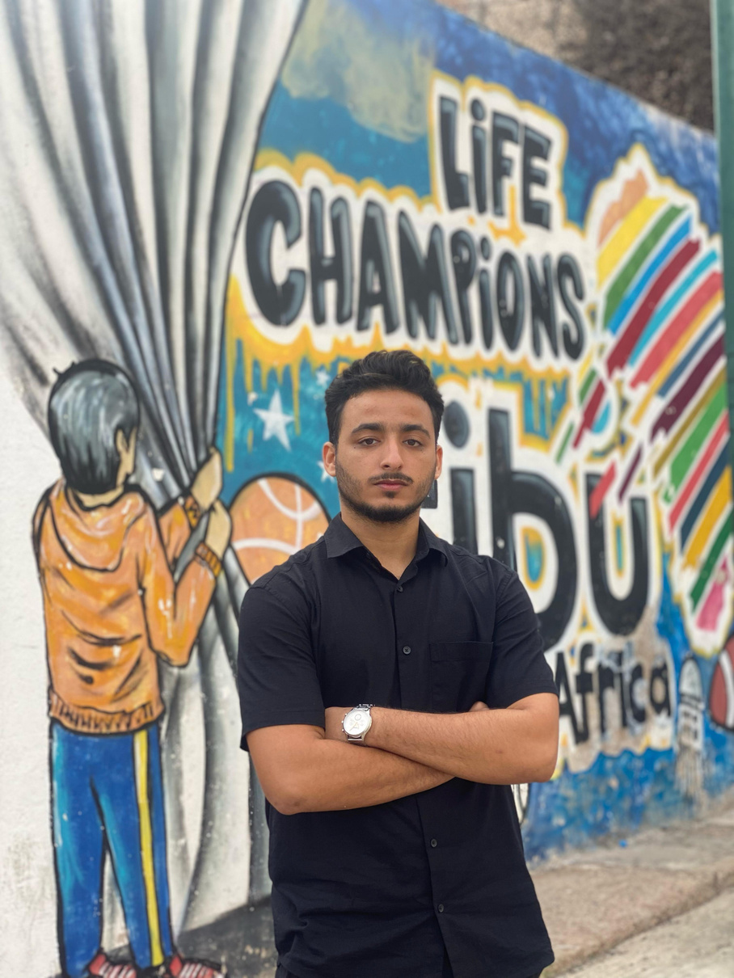
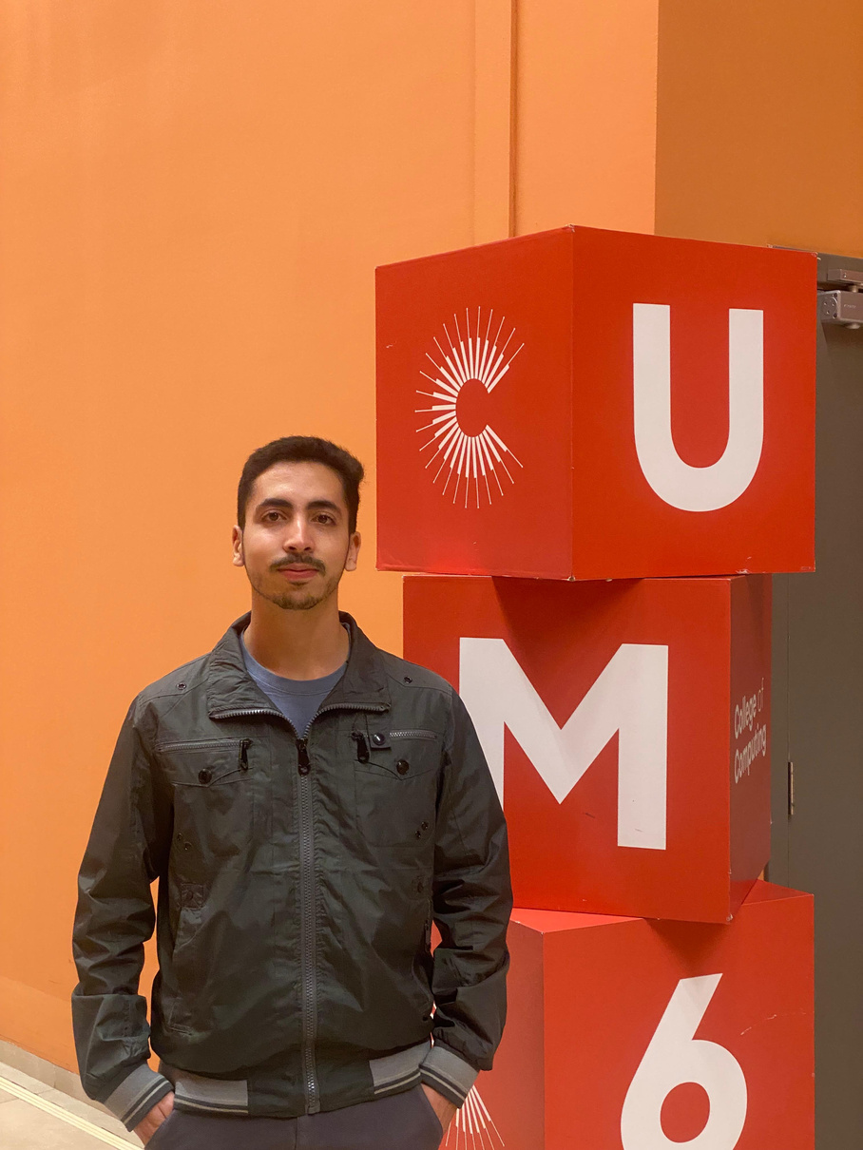
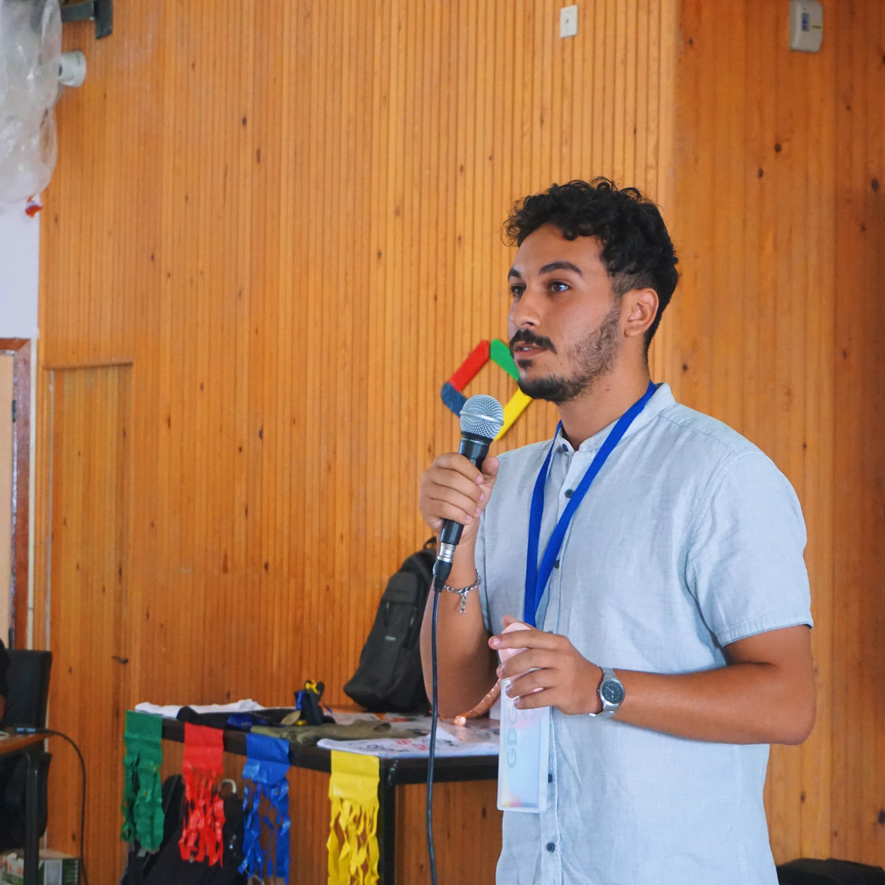
Our Team
Amazzal Youssef
Azmi Zakaria
BENHIMA Mohamed-amine
EL GHAZOUANI Hamza
Hardizi Achraf
Notes:
Finally, here is our team: Ahmed Houssam Bouzine, a frontend engineer; Hamza El Ghazouani, our UI/UX designer; Brahim El Hoube, our backend engineer; and I, Mohammed-Amine Benhima, the AI engineer. Each of us specializes in a different field, bringing the best combination of skills to the project.

Slide 8
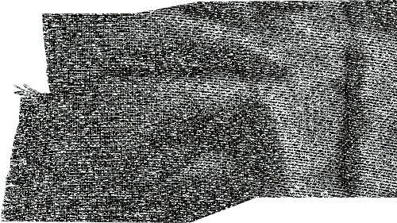
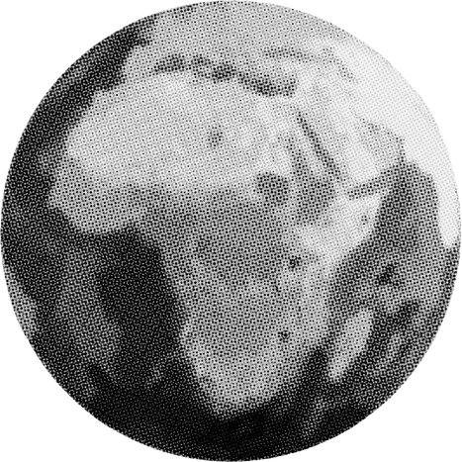



THANKS FOR YOUR ATTENTION
Environmental
sustainability
0-Hunger

Slide 9
Title | Description | Price (DH)
Book | advanture | 50
TV | smart tv 50pouce +wifi | 5000
Bed | Comftorbale Solidaor type | 3000
Client | Phone | email
zakaria | 06666666 | gmail1@gmaim.com
hamza | 06666666 | gmail2@gmaim.com
achraf | 06666666 | gmail3@gmaim.com

